Slide 1
Kinematics
1.1 Distance, Position, and Displacement

Slide 2
VIDEO!
https://www.youtube.com/watch?v=UefWw5k4G0U

Slide 3

the motion of objects
Kinematics is the study of motion
Motion is a change in an object’s location as measured by a particular observer
Distance (d) is the total length of the path travelled by an object in motion
Direction is the line an object moves along from a particular point

Slide 4
Scalar and vector quantities
A scalar quantity only has magnitude (size) [e.g. 5 km, 10 min, 60 km/hr, etc.]
A vector quantity has magnitude (size) and direction [e.g. 8 km NE, 10 m/s W]

Slide 5
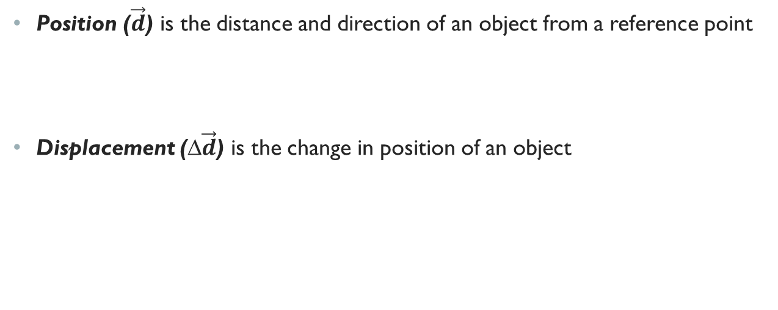
Position and displacement
Position ($\vec{d}$) is the distance and direction of an object from a reference point
Displacement (∆$\vec{d}$) is the change in position of an object

Slide 6
Question #1: Calculating Displacement from a zero starting point by vector subtraction
Imagine that you walk from home to school in a straight route. What is your displacement?

Slide 7
Question: Imagine that you walk from home to school in a straight route. What is your displacement?
Solution:
Given: Solution:
Required:
Analysis:
Statement:

Slide 8
Question #2: Calculating Displacement by vector subtraction
What is your displacement if you walk from your school to the library? Note that all positions are measured relative to your home.

Slide 9
Question: What is your displacement if you walk from your school to the library? Note that all positions are measured relative to your home.
Solution:
Given: Solution:
Required:
Analysis:
Statement:

Slide 10
Question #3: Calculating total displacement by vector addition
One night after working at the library, you decide to go to the mall. What is your total displacement when walking from the library to the mall?

Slide 11
Question: One night after working at the library, you decide to go to the mall. What is your total displacement when walking from the library to the mall?
Solution:
Given: Solution:
Required:
Analysis:
Statement:

Slide 12
Question #4: calculating total displacement by adding displacements in opposite directions
A dog is practising for her agility competition. She leaves her trainer and runs 80 m due west to pick up a ball. She then carries the ball 27 m due east and drops it into a bucket. What is the dog’s total displacement?

Slide 13
Question: A dog is practising for her agility competition. She leaves her trainer and runs 80 m due west to pick up a ball. She then carries the ball 27 m due east and drops it into a bucket. What is the dog’s total displacement?
Solution:
Given: Solution:
Required:
Analysis:
Statement:

Slide 14
Vector Scale Diagrams
A vector scale diagram is a diagram drawn using a specific scale.
A directed line segment is a straight line between two points with a specific direction.

Slide 15
Question #5: using a vector scale diagram to determine the total displacement for two months in opposite direction
Imagine that you are going to visit your friend. Before you get there, you decide to stop at the variety store. If you walk 200 m [N] from your home to the store, and then travel 600 m [S] to your friend’s house, what is your total displacement?

Slide 16
Question: Imagine that you are going to visit your friend. Before you get there, you decide to stop at the variety store. If you walk 200 m [N] from your home to the store, and then travel 600 m [S] to your friend’s house, what is your total displacement?
Solution:
Given: Solution:
Required:
Analysis:
Statement:

Slide 17
Practice
Sophie walks 45 m [E] to a friend’s house. Then, she continues on for a displacement of 20 m [E]. Use a vector scale diagram to determine the car’s total displacement.
A bird flies down 28 m [S] for food and then flies back 52 m [N] to its nest. Use a vector scale diagram to determine the bird’s total displacement.

Slide 18
Summary
Motion involves a change in the position of an object.
Motion can be described using mathematical relationships.
A scalar is a quantity that has magnitude (size) only.
A vector is a quantity that has magnitude (size) and direction.
You can determine the displacement of an object by subtracting the start position from the end position.
You can determine total displacement by adding two or more displacements together algebraically or by using a vector scale diagram.
Vectors can be added by joining them tip to tail.

Slide 19
GAME TIME!
https://play.kahoot.it/#/k/9d287db5-234f-40c4-acfc-4c103dbfd1a1

